Slide 1

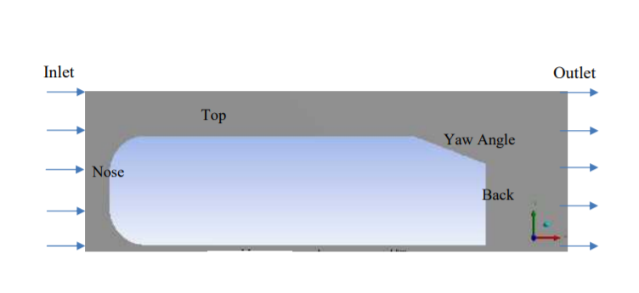
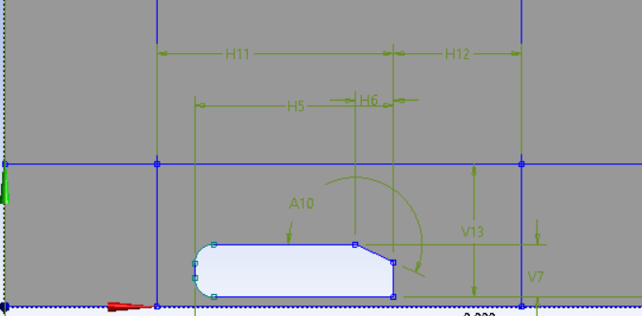
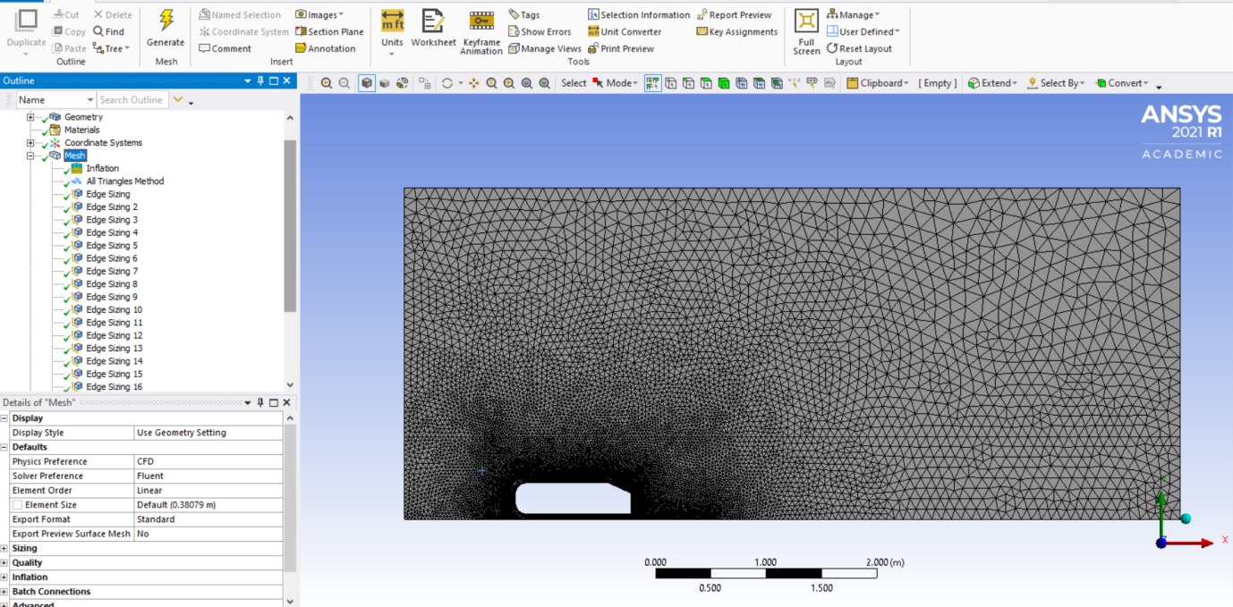
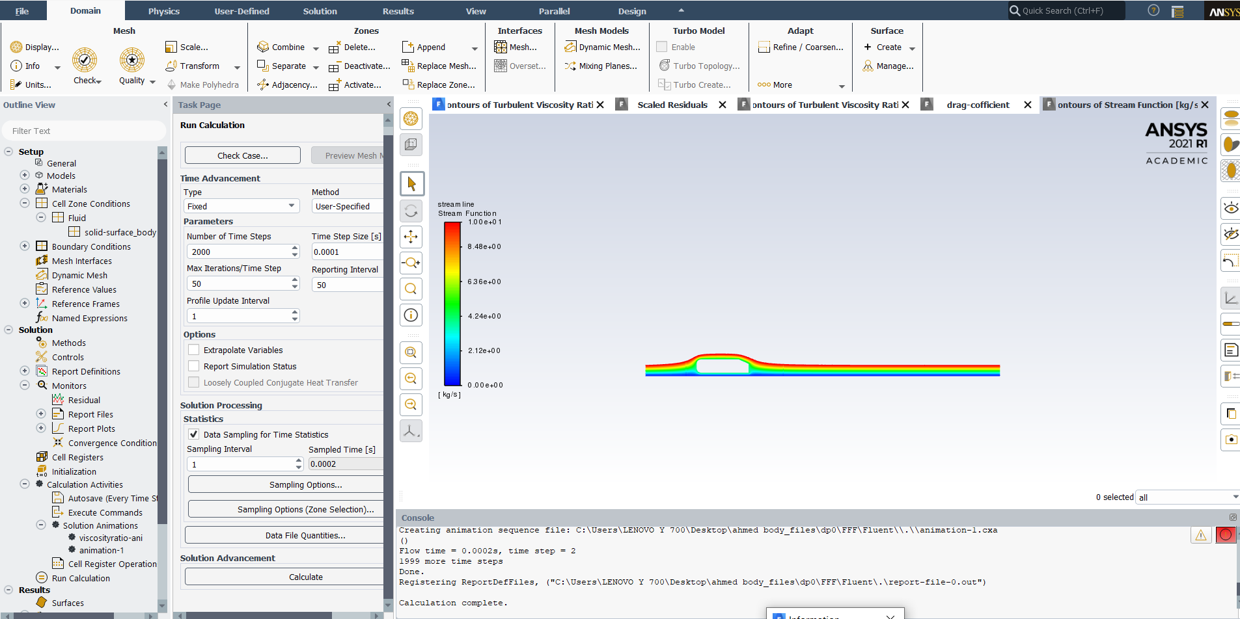
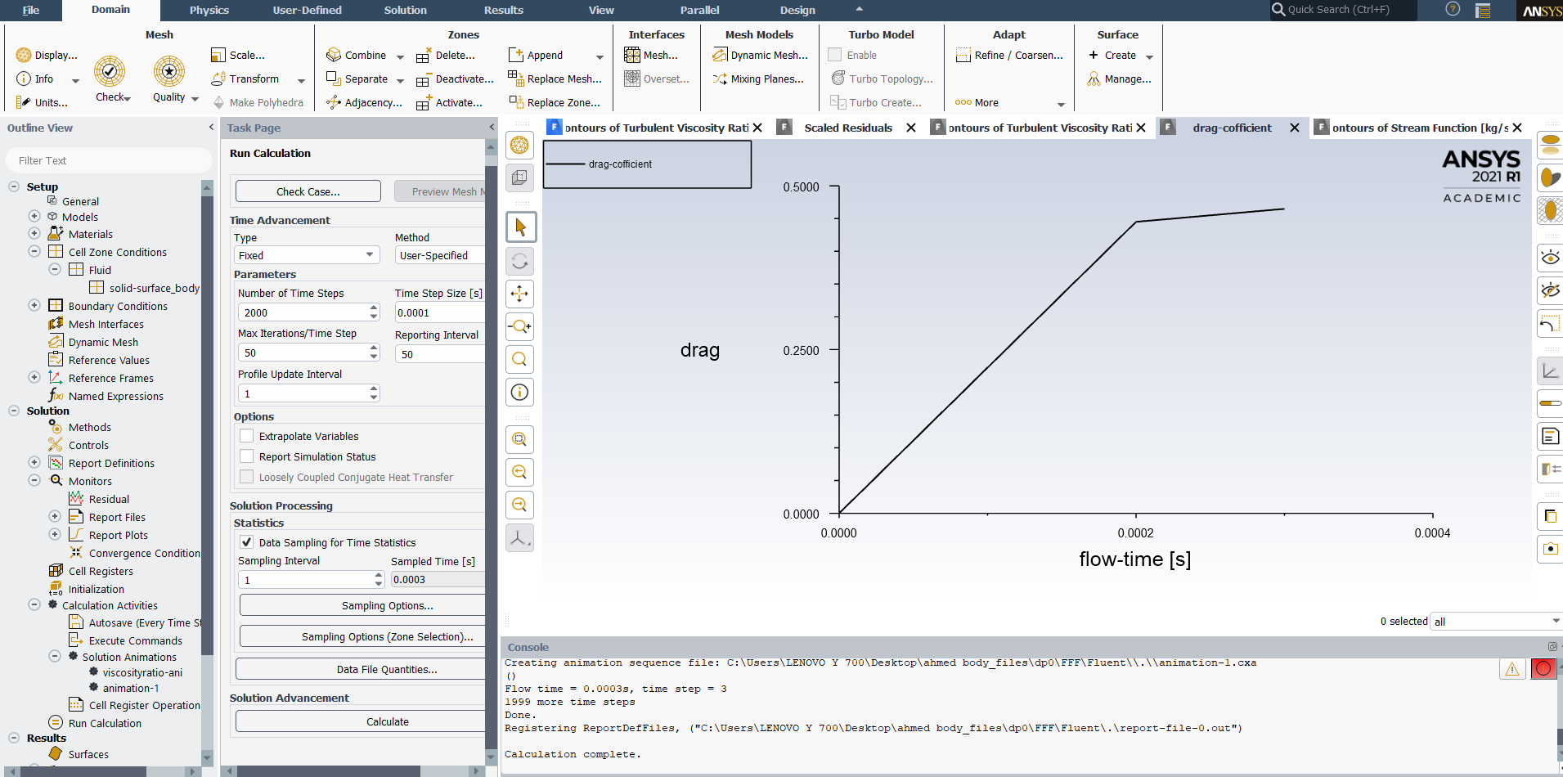
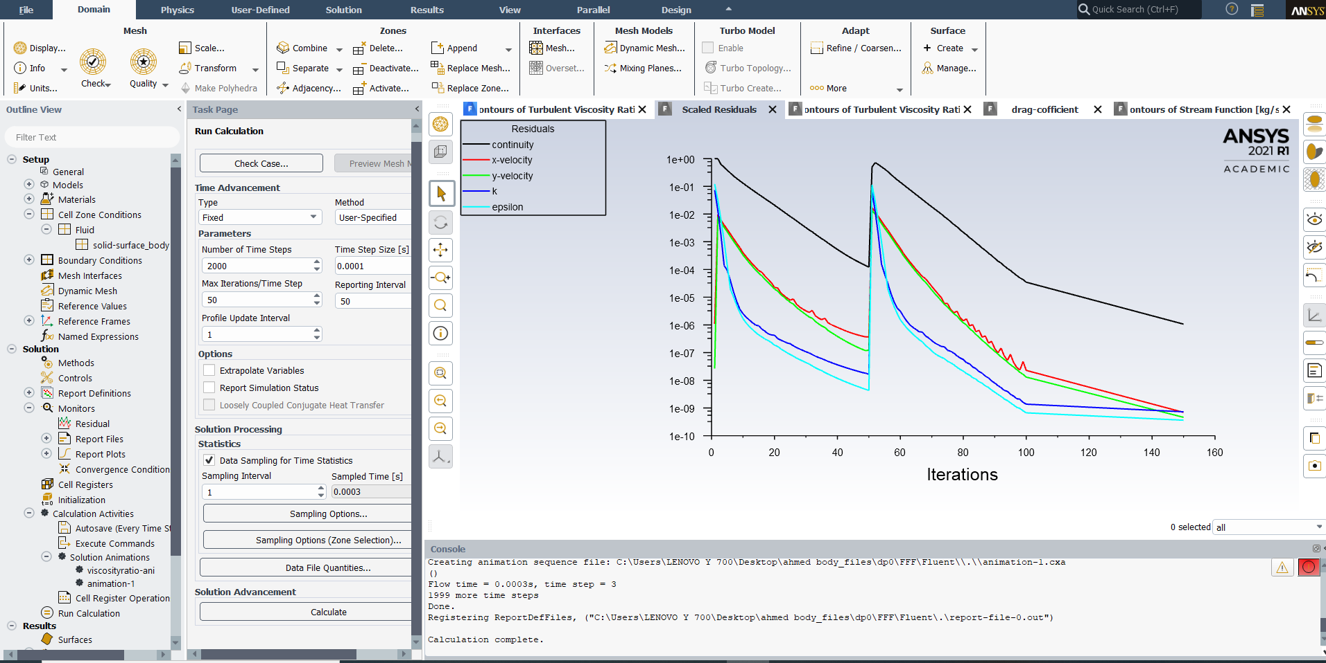
Computational Fluid Dynamics Project
Topic: Simulation of turbulent flow over Ahmed body
Introduction
Objective
Ahmed body (a simplified car body) is a generic car body that captures the essential flow characteristics around this car that means the air flow around the Ahmed body. The main objective of the benchmark validation was to analyse the CFD, and to compare their results with measuring data.
Under normal conditions the flow around road vehicles (cars, buses and trucks) is mainly turbulent. It is usually affected by high dropping and recirculation areas, a complex wake-flow, long vortices and interconnections of vehicle and ground boundary layer flow. It is crucial for the designer to fully understand the structure of the flow around the vehicle while developing new roaders. This will affect such key features as vehicle shape, aerodynamic drag, fuel consumption, noise production and traffic control. Vehicle designers have traditionally gained their knowledge of a vehicle's air flow through extensive wind tunnel tests.
The purpose of Computational fluid dynamic(CFD) is to simulate unsteady turbulent flow over Ahmed body with the help of ANSYS software. In ANSYS we find the turbulent of viscosity ratio, stream function, Drag Coefficient, scaled residual, Axis curved position. In the recent work, the 2D model of Ahmed body consist of inlet, outlet, nose, top bottom, slope
Simulation Design
Mesh Generation
The Ahmed body with geometry dimension.
The 2D computational domain is discretized which has triangular elements. .
Results
Results
Contour of stream function:- The majority of the drag of a bluff body is generated by separation in the rear region of the body and formation of the vortices wake structure, the flow visualization study is focused in this region.
Drag coefficient:-In fluid dynamic, the drag coefficient is a dimensionless quantity that is used to quantify the drag or resistance of an object in fluid environment, such as air
Results
Conclusion
Scaled residual:- The residual is measures of an iterative solution's convergence, as it directly quantifies the error in the solution of the system of equations. In a CFD analysis, the residual measures the local imbalance of a conserved variable in each control volume.
The graphs indicates the trend of this result indicating a different direction as compared to experimental results that showed a linear relation between values of drag coefficients.
In order to analyse the result, velocity and pressure profiles are drawn in order to simulate drag coefficient against different yaw angles. It was observed that the flow is acceptable until 40° and after that flow is diverged in different directions which are not sufficient in order to study the Ahmed body.
Dept. of Mechanical Eng., Galgotias University
Student Instructor
SANDARBH SHUKLA Mr. Faisal Shameem

